Slide 1
TOPIC:
Introduction to Computer Organization & Architecture
(Lecture 1)
By – Dr. Girish Wadhwa (Asst. Professor, DICE)

Slide 2
What is Computer Architecture?
Refers to the those attribute of a system visible to a programmer or those attributes that has direct impact on the logical executions of a program.
It describes the function of various units of digital computers that store and process information.
It is planned, design policy or technology.
What is Computer Organization?
Refers to the operational mints or types and their interconnections that realize their architecture specification.
It provides deep knowledge of functionality, structuring, internal working, and implementation of a computer system.
The role of computer organization comes after Computer architecture.

Slide 3
Computer Architecture vs Computer Organization
Set of rules (also called instructions) and methods describing functionality, organization, and implementation of a computer system
=
Set of rules
Computer Organization
Computer Architecture
┼
=
i.e. program
Deals with operational units of computer and their interconnection

Slide 4
Difference between Computer Architecture and Computer Organisation
S. No. | Computer Architecture | Computer Organisation
1. | They explain what a computer does. | They explain how a computer actually does it.
2. | They majorly focus on the functional behavior of computer systems. | They majorly focus on the structural relationship and deep knowledge of the internal working of a system.
3. | Computer architectures deal with high-level design matters. | They deal with low-level design matters.
4. | It comes before computer organisation. | It comes after the architecture part.
5. | It covers logical functions, such as registers, data types, instruction sets, and addressing modes. | It covers physical units like peripherals, circuit designs, and adders.

Slide 5
Historical Perspective
Computers of today developed over past 65 years
1930’s: Slow mechanical calculating devices
1940’s: Electromechanical devices
First electronic computer using vacuum tubes: University of Pennsylvania
Development of technology used to fabricate processor, I/O, memory divided into 4 generations:
First generation (1945-1955)
Second generation (1955-1965)
Third generation (1965-1975)
Fourth generation (1975-present day)

Slide 6
First generation computers
Idea of storing programs in memory: Von Neumann
Program and data stored in the same memory
Assembly language used to prepare program, translated into machine language instruction for program execution
Magnetic core memory & magnetic tape storage devices developed

Slide 7
Second generation computers
Transistors replaced vacuum tubes
Magnetic core memory
Magnetic disc storage devices developed
High level language developed: easy to prepare program
Compilers or Interprator developed to translate high level language program to assembly and to machine language instructions

Slide 8
Third generation computers
Invention of IC
Cheap and fast processor and memory elements
IC memory replaced magnetic core memory
Introduction of cache memory, virtual memory

Slide 9
Fourth generation computers
Processor and large portion of main memory on a single chip
Millions of transistors on a single chip: VLSI
Processor evolved to microprocessor
Intel, National Semiconductor, Motorola, TI
Architectural concepts evolved
Desktop computer, notebook computer

Slide 10
Historical Perspective
First generation
Second generation
Third generation
Fourth generation
Mechanical & electromechanical devices
Vacuum tube
Transistor
IC
VLSI
1000-fold increase in speed
1000-fold increase in speed
1000-fold increase in speed

Slide 11
Computer Architecture: Von-Neumann/ Princeton
Program and data memory same
Single bus (for address and data)
Instruction fetch and data transfer can’t be same time
Processor
I/O Unit
Program & Data Memory
Address bus
Data bus
Data/Instruction bus

Slide 12
Computer Architecture: Harvard
Separate program and data memory
Separate buses for program and data memory
Instruction fetch and data transfer can be same time
Modified Harvard: separate cache memory, but same main memory
Processor
Program Memory
Address bus
I/O Unit
Instruction bus
Data bus
Data Memory
Address bus
Data bus

Slide 13
Introduction to Digital System
A Digital system is an interconnection of digital modules and it is a system that manipulates discrete elements of information that is represented internally in the binary form.
Now a day’s digital systems are used in wide variety of industrial and consumer products such as automated industrial machinery, pocket calculators, microprocessors, digital computers, digital watches, TV games and signal processing and so on.
Characteristics of Digital systems
Digital systems manipulate discrete elements of information.
• Discrete elements are nothing but the digits such as 10 decimal digits or 26 letters of alphabets and so on.
• Digital systems use physical quantities called signals to represent discrete elements.
• In digital systems, the signals have two discrete values and are therefore said to be binary.
• A signal in digital system represents one binary digit called a bit. The bit has a value either 0 or 1.
Analog systems vs Digital systems
Analog system process information that varies continuously i.e; they process time varying signals that can take on any values across a continuous range of voltage, current or any physical parameter.
Digital systems use digital circuits that can process digital signals which can take either 0 or 1 for binary system.

Slide 14
Continue..
Advantages of Digital system over Analog system
1. Ease of programmability
The digital systems can be used for different applications by simply changing the program without additional changes in hardware.
2. Reduction in cost of hardware
The cost of hardware gets reduced by use of digital components and this has been possible due to advances in IC technology. With ICs the number of components that can be placed in a given area of Silicon are increased which helps in cost reduction.
3.High speed
Digital processing of data ensures high speed of operation which is possible due to advances in Digital Signal Processing.
4. High Reliability
Digital systems are highly reliable one of the reasons for that is use of error correction codes.
5. Design is easy
The design of digital systems which require use of Boolean algebra and other digital techniques is easier compared to analog designing.
6. Result can be reproduced easily
Since the output of digital systems unlike analog systems is independent of temperature, noise, humidity and other characteristics of components the reproducibility of results is higher in digital systems than in analog systems.

Slide 15
Continue..
Disadvantages of Digital Systems
Use more energy than analog circuits to accomplish the same tasks, thus producing more heat as well.
• Digital circuits are often fragile, in that if a single piece of digital data is lost or misinterpreted the meaning of large blocks of related data can completely change.
• Digital computer manipulates discrete elements of information by means of a binary code.
• Quantization error during analog signal sampling.

Slide 16
NUMBER SYSTEM
Number system is a basis for counting varies items. Modern computers communicate and operate with binary numbers which use only the digits 0 &1. Basic number system used by humans is Decimal number system.
For Ex: Let us consider decimal number 18. This number is represented in binary as 10010.
We observe that binary number system take more digits to represent the decimal number. For large numbers we have to deal with very large binary strings. So this fact gave rise to three new number systems.
i) Octal number systems
ii) Hexa Decimal number system
iii) Binary Coded Decimal number(BCD) system To define any number system we have to specify.
To define any number system we have to specify
Base of the number system such as 2,8,10 or 16.
The base decides the total number of digits available in that number system.
First digit in the number system is always zero and last digit in the number system is always base-1.

Slide 17
Binary number system:
The binary number has a radix of 2. As r = 2, only two digits are needed, and these are 0 and 1. In binary system weight is expressed as power of 2.
The left most bit, which has the greatest weight is called the Most Significant Bit (MSB). And the right most bit which has the least weight is called Least Significant Bit (LSB).

Slide 18
Continue..
The human beings use decimal number system while computer uses binary number system.
Therefore it is necessary to convert decimal number system into its equivalent binary.
i) Binary to octal number conversion
ii) Binary to hexa decimal number conversion

Slide 19
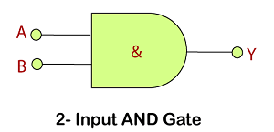
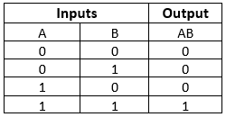
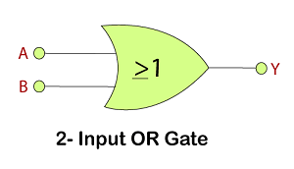
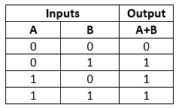
Digital Logic gates

Slide 20
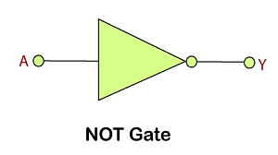
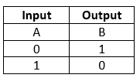
Continue..

Slide 21
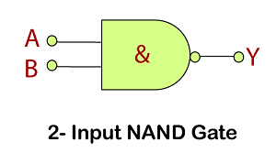
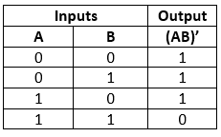
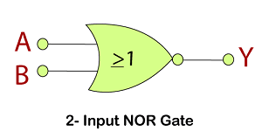
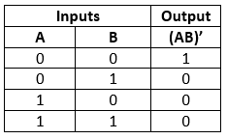
Universal gates

Slide 22
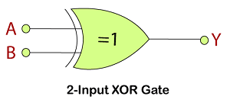
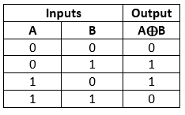
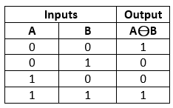
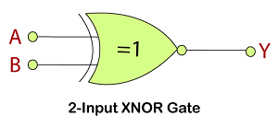
Additional gates

